Slide 1
Stat 447 Presentation

Slide 2
Data Description
Formerly, the data existed separated by brand. After data manipulation, the dataset has 15,086 observations with 6 predictors.
The data in this project includes a number of predictors, both categorical and numerical.
Categorical Predictors: Brand, Make
Numerical Predictors: Year, Price, Mileage, Age

Slide 3
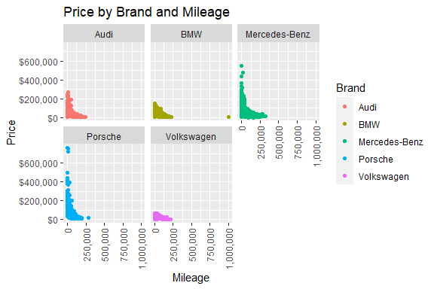
Price Change Across Mileage and Brand
Exponential decay in cost as mileage increases with all car brands.
Volkswagen is the cheapest, has small price range compared to other brands
Porsche is the most expensive initially, but loses value the fastest.

Slide 4
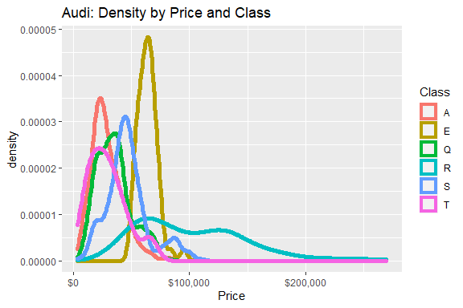
Audi Price Analysis
Right-skews for A, R, and T class cars, left-skew for E class cars.
S-class has a number of relative peaks, indicating clusters of around those figures.
R-class cars have the most variability as the data is almost bimodal with two different peaks.

Slide 5
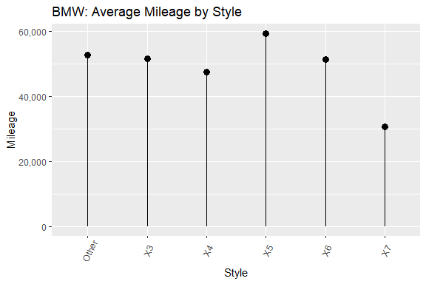
BMW Mileage Analysis
X7’s have the lowest average mileage.
However, X7’s also have the lowest average age.
Low average mileage alone cannot predict price.

Slide 6
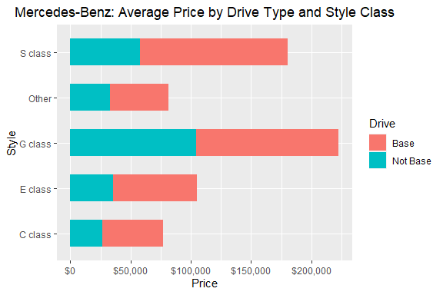
Mercedes Benz Price Analysis
G class is by far the most expensive, followed by the S class and E class.
Price of G class base models are significantly higher than that of other models.
We take this into account for our Mercedes-specific pricing model.

Slide 7
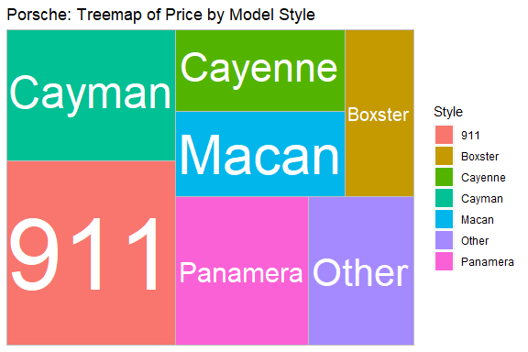
Porsche Price Analysis
911 tends to be significantly more expensive than all other models
Cayenne and Macan are relatively comparable
Cayman and Panamera are similarly priced
Boxster is the cheapest style

Slide 8
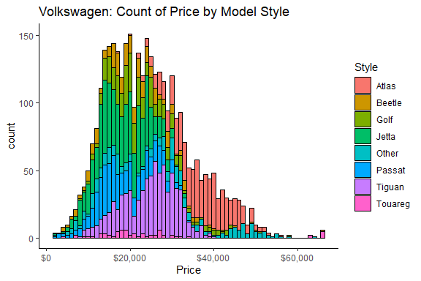
Volkswagen Price Analysis
Atlas’ tend to lie more on the pricier side, making up most of VW’s counts around $40,000.
Jettas and Tiguans in the middle price range of about $20,000-30,000.
Golf and Beetle fall in bottom third of the price range at > $20,000.

Slide 9
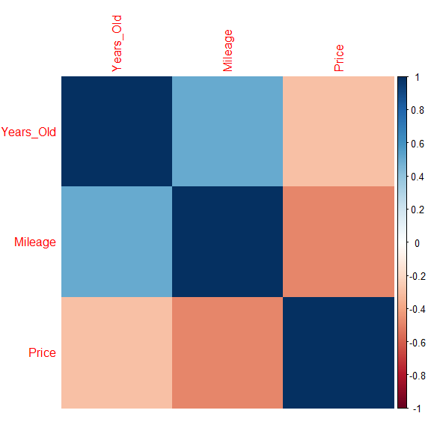
Price Change Across Mileage and Brand
For the full dataset, there is no strong correlation amongst our predictors (reducing multicolinearity) which may otherwise exist.
Price and Mileage are negatively correlated, while Years_Old and Mileage are positively correlated.

Slide 10
Price Change Across Mileage and Brand
 | Df | Sum Sq | Mean Sq | F value | Pr(>F)
Years_Old | 1 | 1.730883e+12 | 1.730883e+12 | 2413.459 | 0
Brand | 4 | 3.904470e+12 | 9.761175e+11 | 1361.050 | 0
Mileage | 1 | 2.078791e+12 | 2.078791e+12 | 2898.563 | 0
Years_Old:Mileage | 1 | 2.660116e+11 | 2.660116e+11 | 370.913 | 0
Brand:Mileage | 4 | 1.073350e+12 | 2.683375e+11 | 374.157 | 0
Residuals | 15074 | 1.081077e+13 | 7.171797e+08 | NA | NA

Slide 11
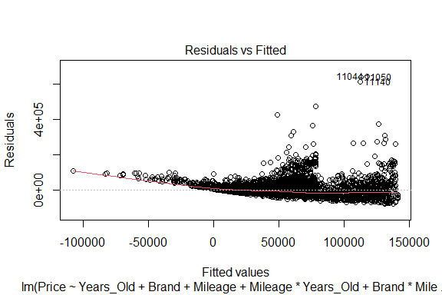
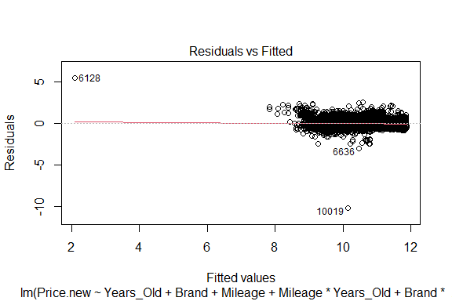
Model Transformation

Slide 12
Brand-Specific Models
Audi: 9 predictors, 0.8985 adj R-squared
BMW: 9 predictors, 0.7476 adj R-squared
Mercedes Benz: 14 predictors, 0.6941 adj R-squared
Porsche: 5 predictors, 0.8611 adj R-squared
VW: 5 predictors, 0.8325 adj R-squared
Across all brands, we see this BIC model perform quite well with a high adjusted R-squared values.
The models have a very similar construction, following the similar transformation methods from the full model.
Overall, we feel confident in our analysis and our ability to predict car prices.

